Slide 1
Varsity Parents Meeting Fall 2018

Slide 2
MJRC Coaches
Program Director: Hilary Gehman
hgehman@rowpnra.org 609-799-7100 x107
Varsity Girls: Matt Carlsen
mcarlsen@rowpnra.org 609-799-7100 x 102
Varsity Boys: Jamie Hamp
jhamp@rowpnra.org 609-799-7100 x 103
Novice Girls: Anna Kalfaian
akalfaian@rowpnra.org 609-799-7100 x 106
Novice Boys: Leigh Warner

Slide 3
Assistant Coaches
Varsity Girls Assistant Coaches
Sophia Vitas
Coco Schoeller
Rena White & Katie Sessa – temporary
Varsity Boys Assistant Coaches
Kyle James
TBD

Slide 4
Program Dates and Times
September 9th- Varsity Starts
November 16th- Last day of Fall
Varsity practice-
Monday- Friday: 4:00-6:45 PM
Sunday: 7-9:30 AM
Saturday: OFF

Slide 5
College Visits and Test Dates
Check race schedules and communicate with your coach regarding ALL test dates and college visits
SAT test dates
Oct. 6 (Head of the Housatonic)
Nov. 3 (Mercer Fall Classic)
Dec. 1
March 9, 2019
May 4, 2019
June 1, 2019
ACT test dates
Oct. 27
Dec. 8
Feb. 9, 2019
April 13, 2019
June 8, 2019 (Youth Nationals)
July 13, 2019

Slide 6
Team Expectations/ Culture

Slide 7
Fall Race Schedule
Mercer Lake Challenge – Wednesday, September 26 (all PNRA programs, during practice), Mercer Lake
Head of the Housatonic- October 6 (3 varsity 8s, 1 novice 8) Shelton, CT
Head of the Charles – October 20-21 (2 girls 8s, 1 boys 8), Boston, MA
Head of the Schuylkill – October 28th (select varsity and novice), Philadelphia, PA
Head of the Halloween – October 31st (all athletes, during practice)
Mercer Fall Classic – November 3 (all athletes), Mercer Lake

Slide 8
Trip Fees
Head of the Housatonic - approx. $300/athlete
Head of the Charles – approx. $650/athlete
Trip fees will be posted roughly one week prior to the event and need to be paid within 2 weeks after the event.
There will be a late fee of $15 added to the trip fee if not paid within 15 days of the event.

Slide 9
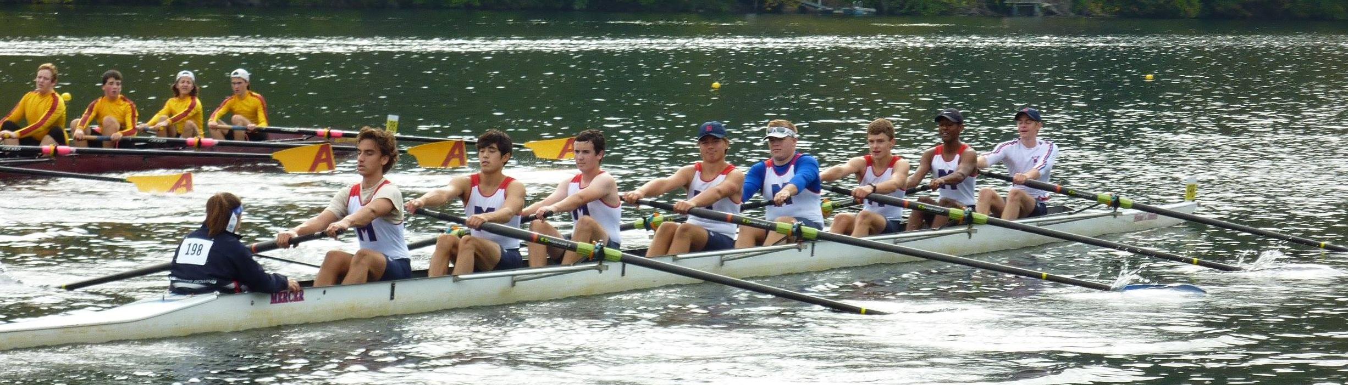
Attendance Policy
24 hours (or more) prior to an absence please fill out Absentee Form found on the website.
If it’s a sickness or last minute emergency, less than 24 hours, please email coach in addition to filling out the form.
Attendance affects boating assignments!

Slide 10
Communication
Blog will have information about practice, regattas, gear, and events taking place at the boathouse.
Text PNRA to 313131 to sign up for the emergency message system.
‘Parents of MJRC’ Facebook page
Each team (Varsity Girls and Varsity Boys) has a Facebook page which is for athletes only
Parent Coordinators are available to help communicate race logistics, answer questions, etc.
Encourage your athlete to communicate directly with his/her coach.
Please DO NOT text the coaches unless it is an emergency

Slide 11
Parent Coordinators
Boys Team-
Jen Closser- closserj@gmail.com
Erin Wright – wrighter16@gmail.com
Girls Team-
Jeb Barkenbush- jebarken@gmail.com

Slide 12
Injury and Nutrition
Injured? See a doctor. Coaches will need a physician’s clearance to allow rower back to practice after sustaining an injury.
Sore? Stretch. Heat before, ice after activity.
Not sure which? Talk to your coach, but athletes are encouraged to pay close attention to how their bodies are feeling on a daily basis (sharp pain is in the injury category)
Nutrition is important! Send healthy snacks to practice.

Slide 13
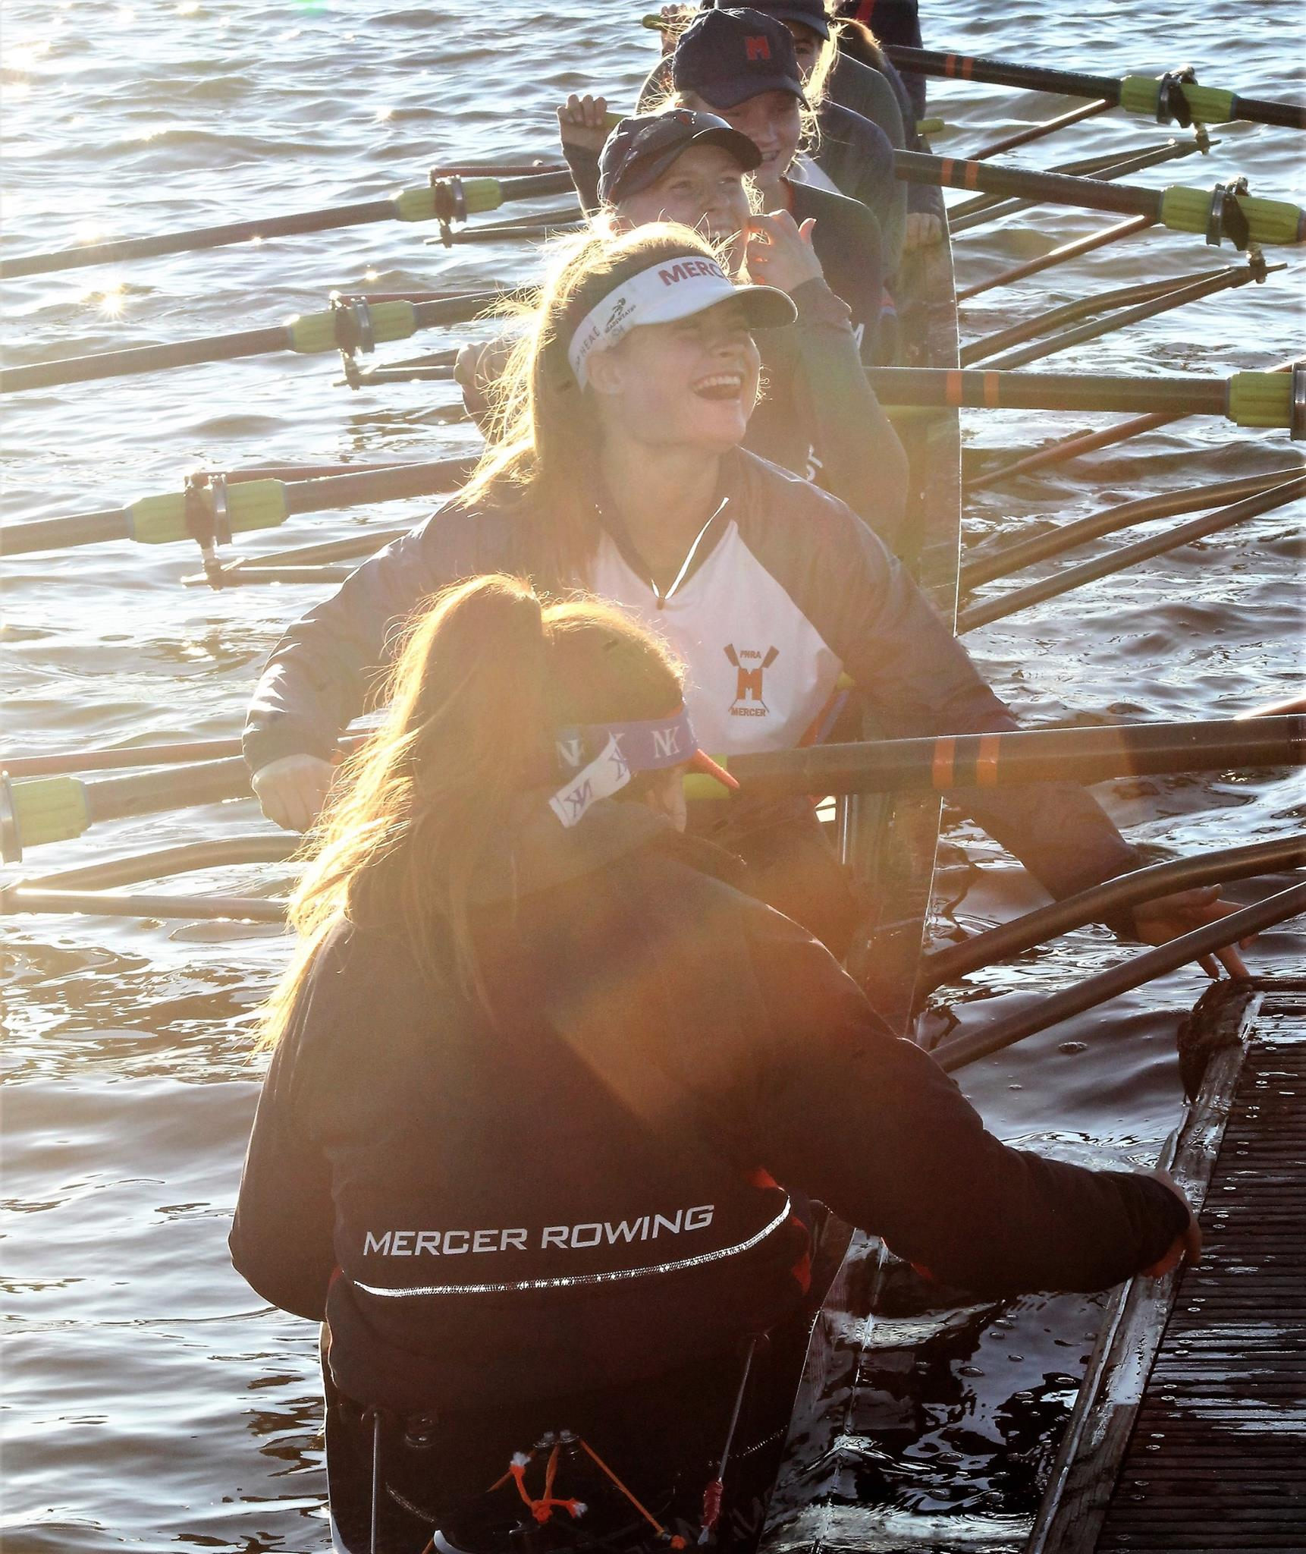
Fall Weather
Please be prepared for cold
temperatures!
Bring extra clothes!
Always have sneakers!
Label all clothes!
Changes to practice due to weather will be posted on 313131 or the blog.

Slide 14
Regattas - Volunteering
Mercer hosts a number of regattas throughout the year which could not be possible without the volunteers.
For all Mercer home regattas, there is a Family Commitment to volunteer 4 hours per event.
Launch drivers are crucial (and a great way to watch the races)
Kevin Heyeck is our Volunteer Launch Driver Coordinator

Slide 15
Additional Information
JL Store is open until Monday. Check blog post for more information. All varsity athletes need the JL unisuit.
Spring races: Mercer Lake Sprints falls on Easter weekend in 2019. Races will be Friday, April 19 and Saturday, April 20
Late fees: there will be a $15 late fee applied to any payment not received within 15 days of the event or start date of the season.
Register for Fall Season on RegattaCentral (late fee applies on Tuesday, Sept 25)
Trenton transportation – interest or ideas in helping?
Oktoberfest – Saturday, October 13
PNRA/Mercer Fundraiser – TopGolf Sunday, November 18
Confidential Reporting Hotline
College Night: Monday, Sept 24 at 7 pm at the boathouse

Slide 16
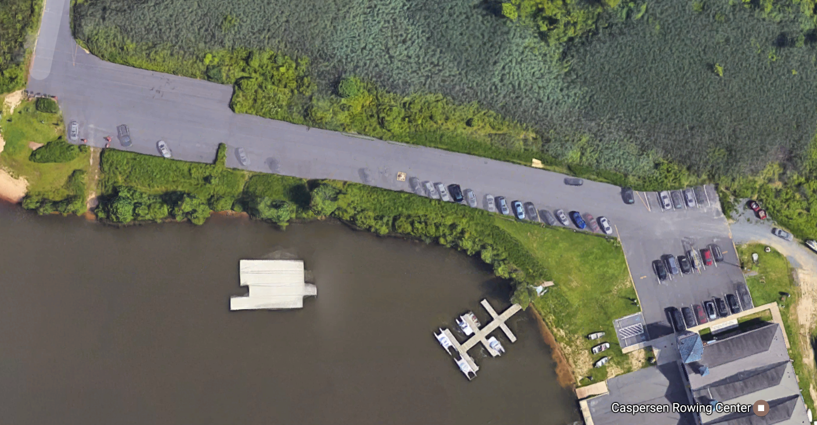
Boathouse Safety
Access Road Speed Limit 25 mph!
Slow around the turn!
Red zone:
Drop off – Pick up
No waiting!
Keep Open for Emergency vehicles
Bus parking
Green zone:
Waiting zone
Keep avenue open for Emergency vehicles
Coaches parking

